Slide 1
Woolly apple aphid and earwig modelling
Hayden Tempest

Slide 2
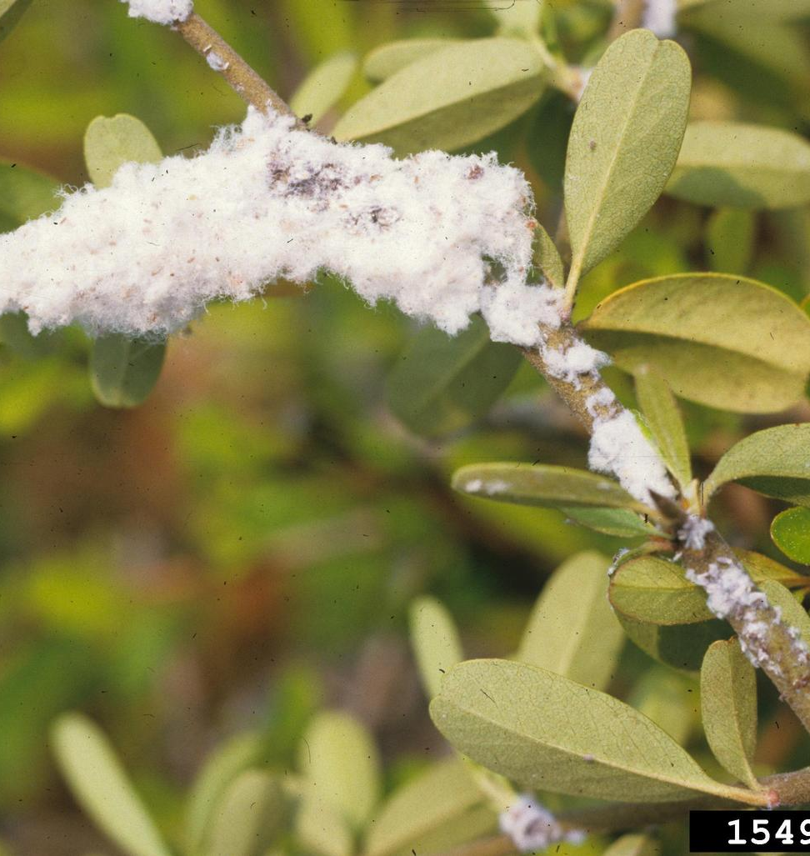
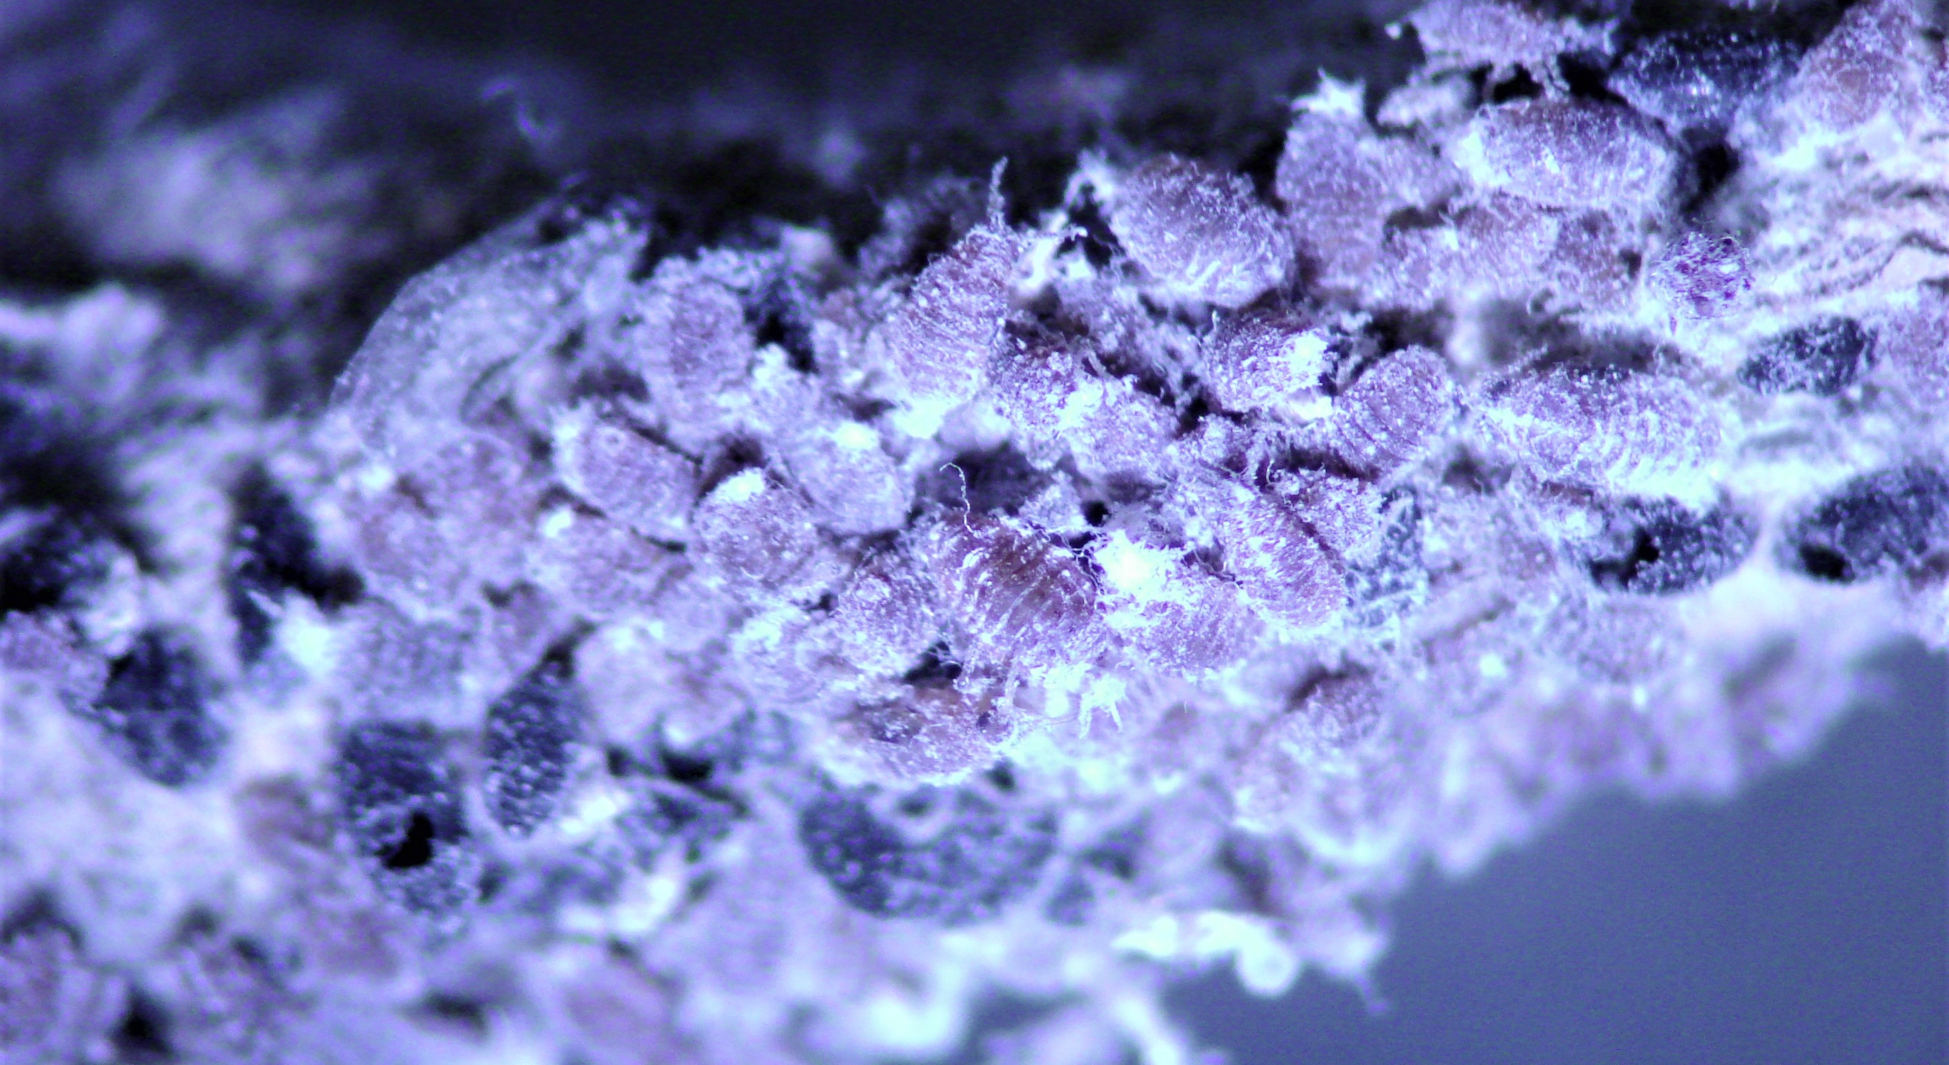
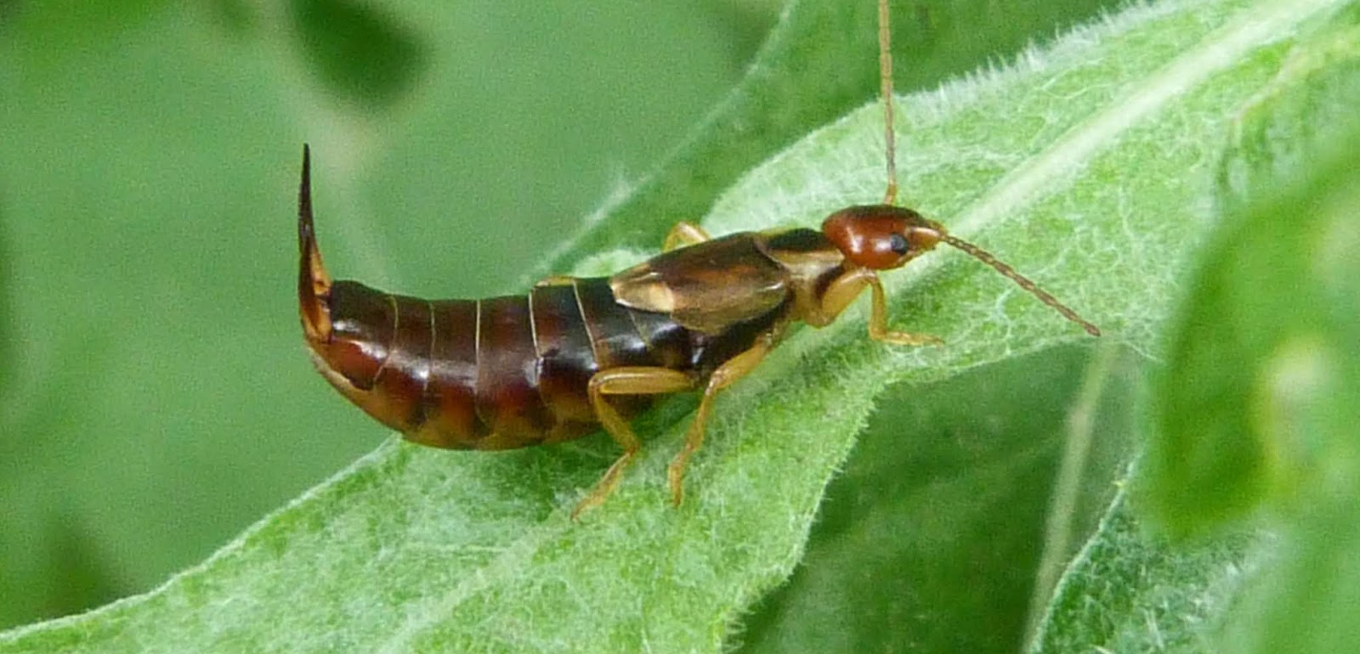

Slide 3
Cut to raw data

Slide 4
My variables
Dependent variables
Independent variables
‘Explanatory factors’
Labels
Geographic area
Farming system
Orchard age
Rows per bed
Moss score
Algae score
WAA count
Earwig count

Slide 5
Cut to average count data

Slide 6
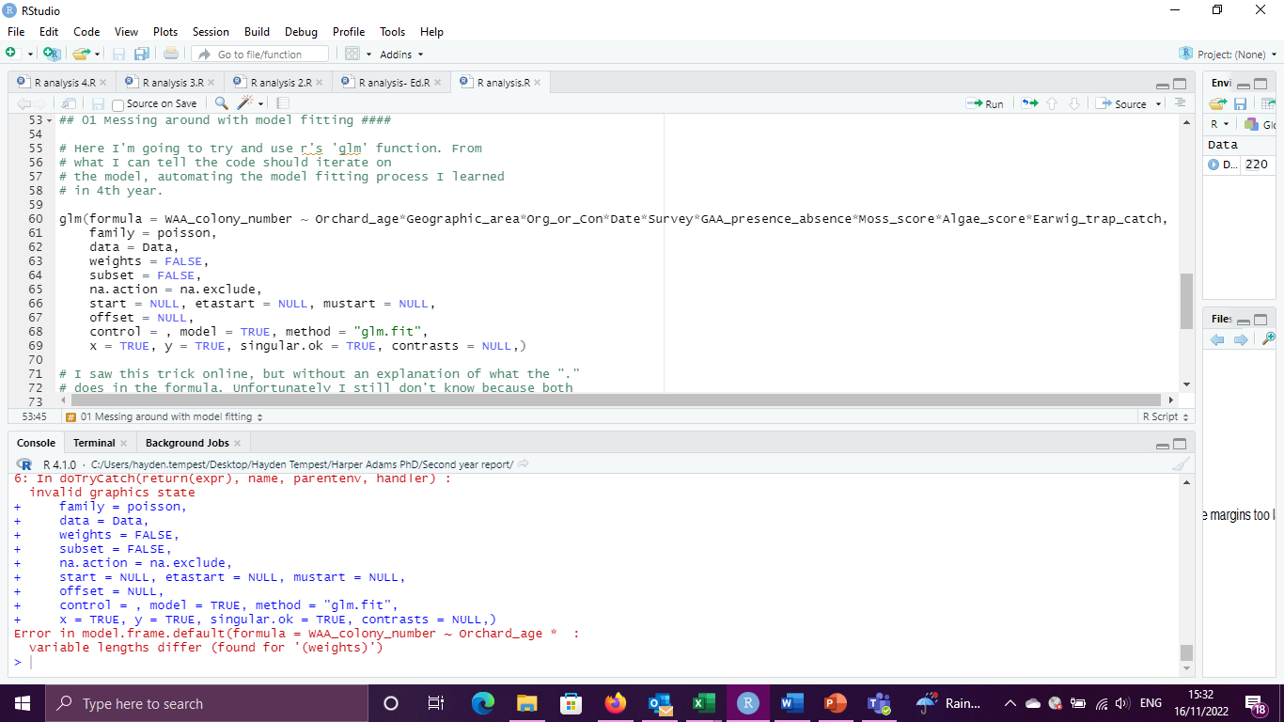
First go at model fitting (went badly)
9 variables, each separated by an ‘*’

Slide 7
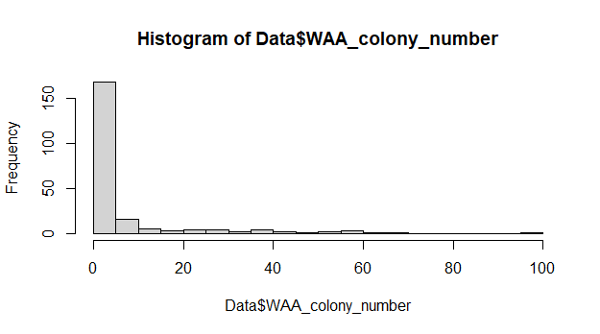
Ed to the rescue
9 variables, each separated by an ‘*’
=
Over 500 possible factors and interactions

Slide 8
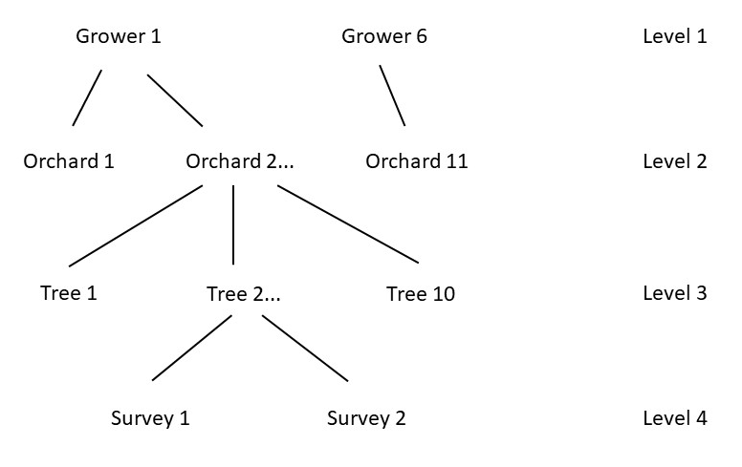
Data structure
Explanatory factors at each level
Geographic area
Farming system, orchard age, rows per bed
Moss score, algae score
WAA presence, earwig presence

